Slide 1
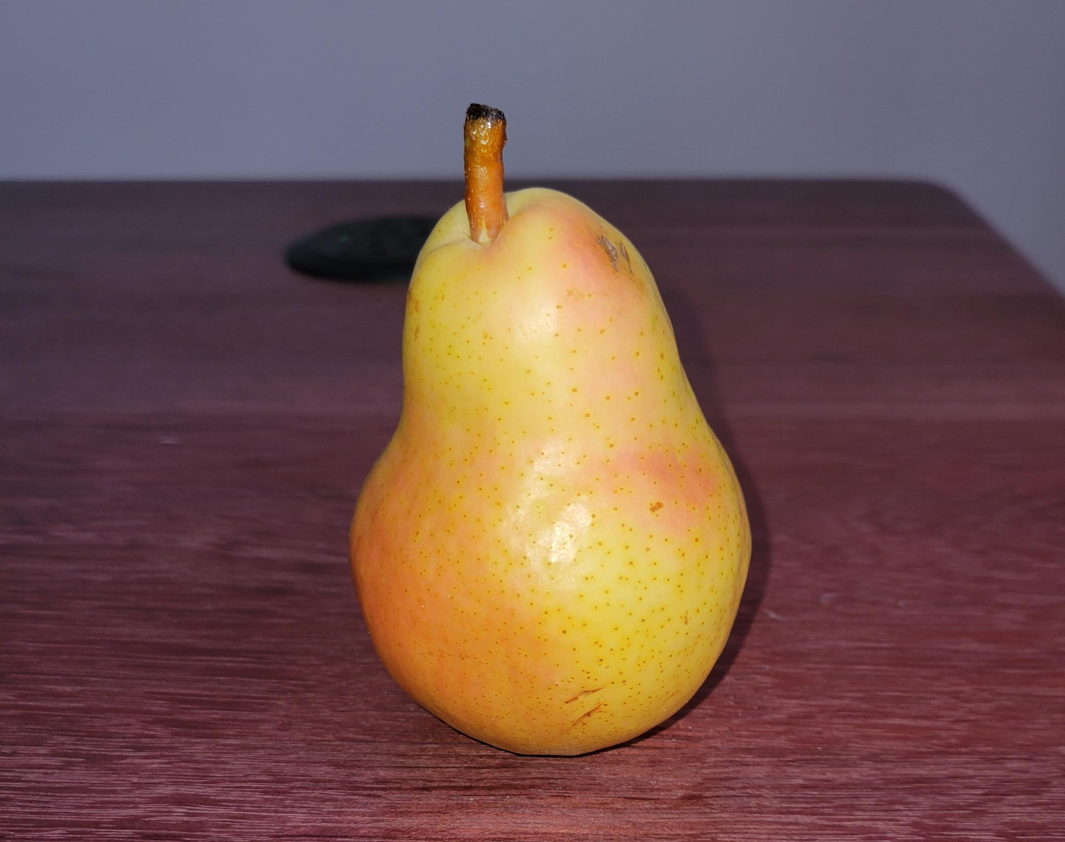
What is a pear?
Object VS Class
Notes:
Most powerful concept in OOP

Slide 2
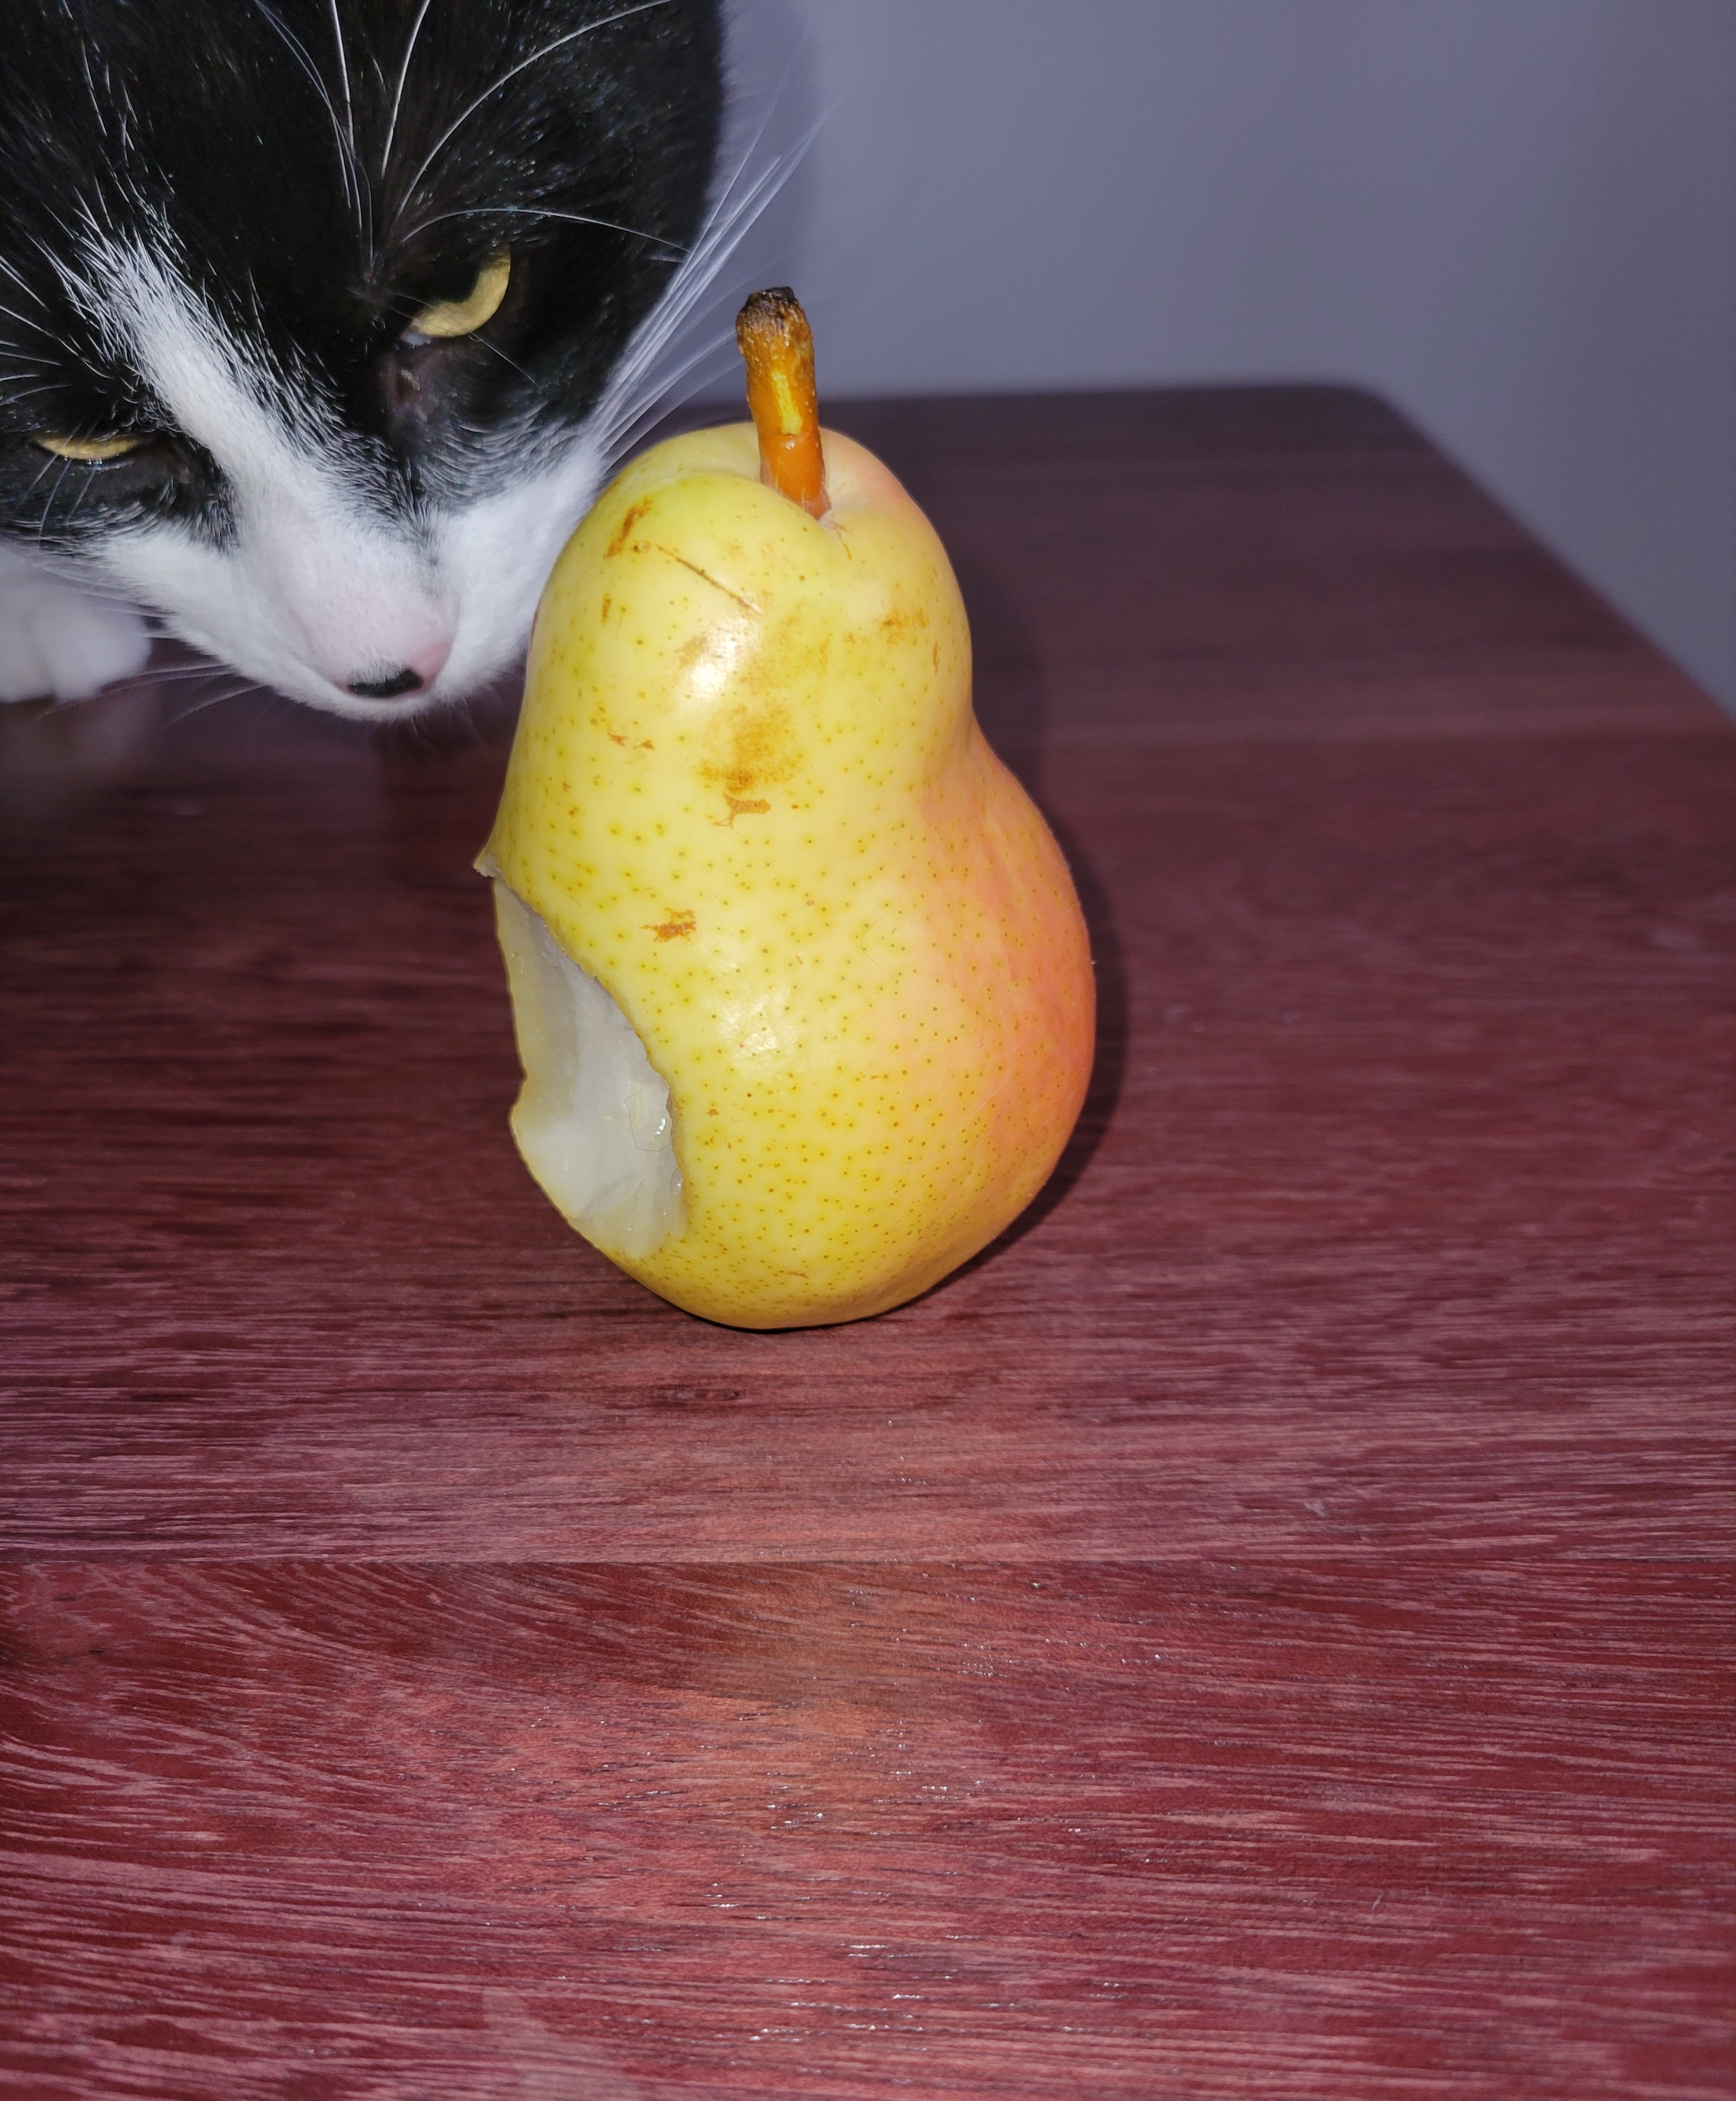
What is a pear?
The Object
This is a single pear out of an infinity of them.
Properties :
Its color
Is it fresh?
Is it eaten?
Is it been eaten?
...
Interaction
Eat
Dispose
Thrown
…
Notes:
Concept of object is the base of OOP and functional programming. It is the most powerful tool of OOP. Inheritance/polymorphis are just adding functionality and improving the code.

Slide 3

What is a pear?
The Class
This is a definitions of both the properties and interactions with a single pear.
Ask yourself: What do I (the program) need to interact with a single instance of pear?
Example:
Color : RBG|string|Enum
Void Eat(){…}

Slide 4
What is a pear?
The Struct
This is a definition of a new building block. This is like defining a new type of integer.
In practice, this is light version of a class with multiple functionality removed or behavior changes. They cannot be inherited and they behave more like an int, char, or any other base type.
Notes:
In fact, most base type (except string) are struct.
We will cover more the struct in course about Garbage collection and pointers.

